Slide 1
Assessment Tasks
Kayla & Lizy

Slide 2
Goals After today students should be able to:
Explain the importance of assessment
Describe at least 3 types of assessments
Analyze use of assessments in two case study examples

Slide 3
So, what is an assessment?

Slide 4
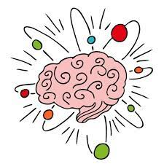
What does assessment mean to you now?
As a student, what do you remember about how assessments were presented to you?

Slide 5
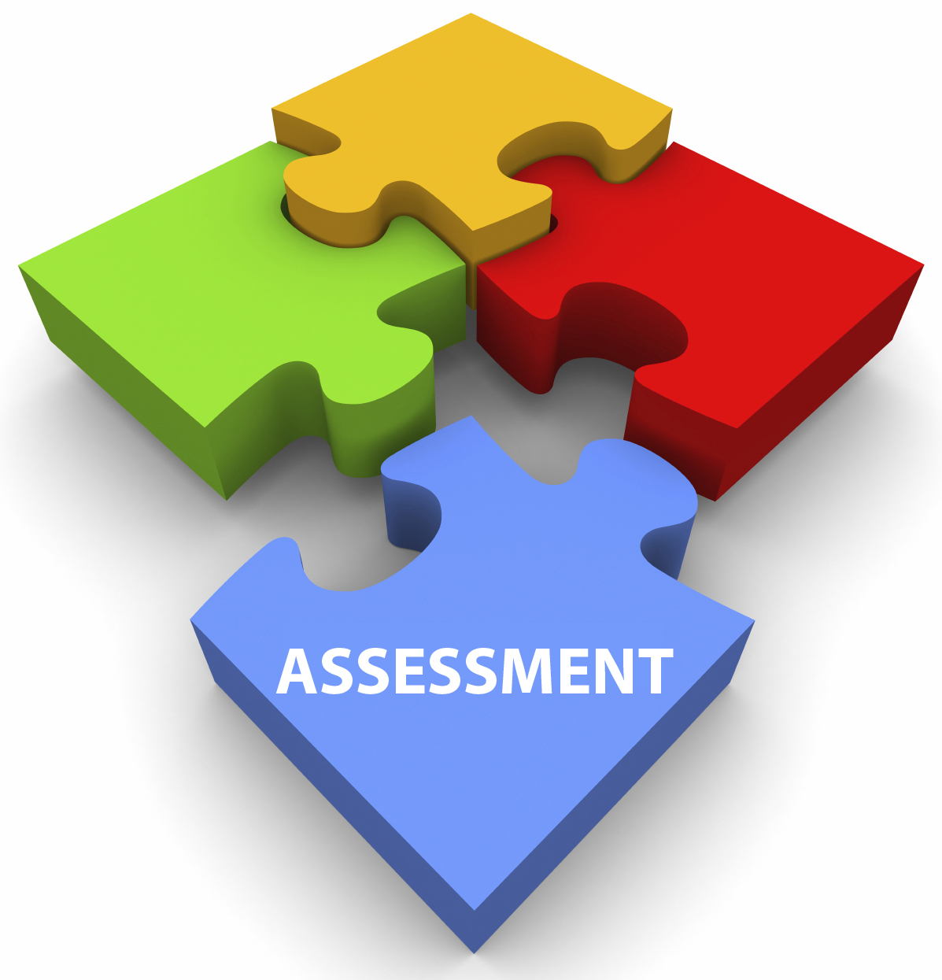
Why use assessments?
Helps record student performance levels on content
Which also helps identify areas of improvement for students
Can be implemented as a tool of a deeper understanding of the learned content

Slide 6
Why Use Assessments
“While students often complain about increased anxiety and stress related to test taking…research in cognitive science and psychology shows that testing, done right, can be an effective way to learn. Taking tests can produce better recall of facts and a deeper understanding than an education devoid of exams.”
(Paul, 2015, p. 54)

Slide 7
Types of Assessment

Slide 8
Formative
Occurs as students are forming their learning
Reflection questions
Quizzes, especially with options for retakes
Should be brief, frequent, and timely.
Allows teachers to make changes based on students needs.
Summative
Assesses the sum of what has been learned
comprehensive exams
standardized tests
final thesis paper
Intended to capture sum of knowledge over specific time.
Not great for learning since there is no or little opportunity to make improvements.

Slide 9
Examples of Formative Assessment
Student Self Assessment
Standard Checks & Frequent Quizzes
“Self scoring technique is one of the ways that students gain the confidence that they are learning and that every lesson contributes to the gains” – Pollock & Tolone, 2021, p. 83

Slide 10
Goal Sheets
Teacher tells the goal or objective for the class
Students rate themselves on this goal (i.e. 1-4)
After the lesson, students rate themselves again on the same scale.
Can be done electronically, written, or movement (i.e. raise hands, move into groups).
Put goal somewhere visually to regularly check in
Goal | Before | After
I can explain the importance of assessment in learning environments.
1 – I know nothing of this topic, 2 – I know a little or need a refresher, 3 – I know a lot, 4 – I can teach someone else about it

Slide 11
Value of Self Assessment
Students become responsible for their own learning
Students are able to see progress in real time
Student progress can inform future lesson plans

Slide 12
Frequent Quizzes
- Multiple short quizzes offered frequently tends to produce better outcomes than simply repeating or reviewing information
- quizzes should be announced and not a “surprise” for best learning outcomes
- To help retain knowledge incorporate material from previous lessons, known as interleaving
- Standard checks are similar in that they provide frequent, brief assessments based on some standard being learned. Helpful to prepare for standardized exams.

Slide 13
How do you learn and retain information?
Research suggests that most strategies that people use such as reading, highlighting, underlining, and repeating it over and over are a waste of time.

Slide 14
Building Pathways
Recalling information through self assessment, frequent quizzes, explaining material to someone else, or even study techniques like flashcard helps build the pathway of retrieving information.

Slide 15
So how does this help students learn?
"The purpose of thinking is to generate new ideas."
(Pollock & Tolone, 2021, p. 93)

Slide 17
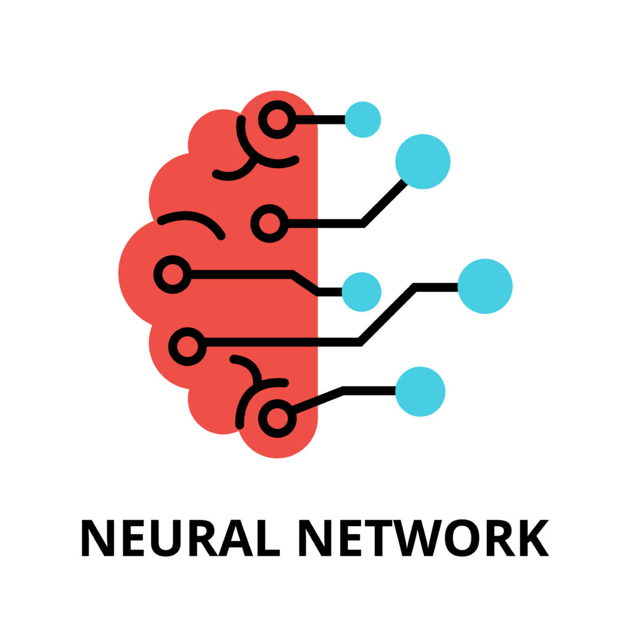
A Neuroscience lens
Building neural networks stems helps with:
Processing information and remembering it by creating new connections and knowledge
With the GANAG model, students can reorganize new information that is given to help them gain insight that makes sense to them

Slide 18
Thinking skills

Slide 19
Association
compare
Classify
Make analogies
Being able to identify similarities and differences
Grouping items together that share similar traits
Recognizing patterns or relationships between situations that are both known and unknown

Slide 20
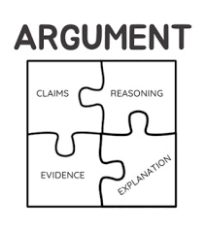
Synthesis
Investigate
Construct an argument
Explaining different topics via theme, including contradictory or ambiguous information
Make a statement that can be reinforced with information such as evidence and examples

Slide 21
Analysis
Analyze perspectives
Analyze systems
Analyze reasoning for errors
Giving thought into different perspectives on an issue
Understanding how individual aspects impact the whole
Identifying errors in logic

Slide 22
Taking action
Adapting and navigating different obstacles to find a good solution
Making a decision upon choices that are similar
Observation, Experimentation, and Explanation
Creating an item or procedure that aligns with standards and goals
Solve
Decide
Test
Create

Slide 23
Thinking Skills for Helping Professionals
Association for counselors:
Empathizing with clients
Recognizing recurring themes in a client's narrative
Relate a client's past experiences with their current dilemma
Synthesis for counselors:
Asking questions to understand the roots of a client's challenges and feelings
Utilizing information from past sessions to help the client gain a fuller understanding of their dilemmas
Connecting narratives they offer with evidence from a theoretical lens or other situations previously experienced

Slide 24
Thinking Skills for Helping Professionals
Analysis for counselors:
Identify underling issues that may not be apparent
Recognize and discuss coping mechanisms that a client presents
Analyze the effectiveness and possible outcomes of the coping mechanisms
Taking Action for counselors:
Collaboratively setting goals both short and long-term
Planning personalized interventions and strategies to help the client with their goals
Check-in with the client's progress and adapt to the plan as needed
Empower the client with resources and tools

Slide 25
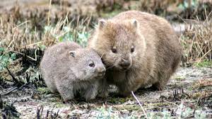
LESSON PLAN EXAMPLE: WOMBATS AND THEIR LIVES
Association:
Ask students to compare wombats with other animals based on habitat and size
Have students classify different species of wombats based on habitats
Make analogies by having students compare wombats to other animals based on behaviors
2. Synthesis
Students will explore habitats of wombats
Challenge students to debate which habitats are the safest for wombats
3. Analysis
Discuss different views on how to best protect wombats
Analyze different conservation efforts
Identify challenges the conversation efforts face
4. Taking Action
Brainstorm as a class solutions to habitat challenges wombats face
Ask students how to wombat (combat) this.
Students will choose the most effective conservation strategy
Create a class presentation on wombat conservation

Slide 26
CasE Study #1
Mrs. Clark excitedly unveiled the class's newest tool: a digital assessment platform. This allows them to revisit questions they got wrong immediately. Jamie, who is always nervous about waiting days for her results, felt a weight lift off her shoulders. She loved the chance to correct her mistakes immediately and understand her errors. Mrs. Clark noticed that not only did grades improve, but students' confidence in their abilities flourished as they felt more in control of their learning journey.
How did the introduction of the digital assessment platform alter students' perspectives on evaluations?
What immediate advantages did Jamie perceive in the new assessment system?
What are potential challenges teachers might face when implementing digital feedback systems in their classrooms?

Slide 27
CasE Study #2
Mr. Adams believed that one's learning isn't defined by one's performance on a single day but is an accumulation of efforts over time. He introduced portfolio-based assessments.
Throughout the term, students collected samples of their work, from essays to projects, reflecting their best efforts and improvements. At the term's end, Leah presented her portfolio, showcasing her progression and highlighting areas she felt proud of. Mr. Adams, having the chance to see Leah's journey, could provide more comprehensive feedback, helping her recognize her growth and areas for continued development.
How does a portfolio-based assessment differ from traditional examination-based assessments in evaluating a student's capabilities?
How does collecting and reflecting on a term-long portfolio help students like Leah in their academic journey?
What are the potential benefits to educators when assessing students using portfolios?

Slide 28
Our Goals for today:
Explain the importance of assessment
Describe at least 3 types of assessments
Analyze use of assessments in two case studies

Slide 29
Let’s Assess your knowledge
https://create.kahoot.it/my-library/kahoots/bc410a04-b439-4b3a-b18d-1cddc4e0d856

Slide 30
Anonymous Feedback

Slide 31
References
Lai, E. R. (2011). Critical Thinking: A Literature Review. Educational Testing Service. http://images.pearsonclinical.com/images/tmrs/tmrs/CriticalThinkingReviewFINAL.pdf
Pollock, J. E., & J., T. L. (2021). Improving student learning one teacher at a time. Association for Supervision and Curriculum Development.
Paul, A. M.,(2015). “A New Vision for Testing“. Scientific American 313, 2, 54-61 doi:10.1038/scientificamerican0815-54

